Slide 1
BINF 4002
Lecture 3: Probability

Slide 2
Today’s Class: Probability

Slide 3
Outline
What are random variables?
Expectation
Joint random variables

Slide 4
A Probability Triple is samples, events, and a measure
Formally, a probability triple (𝑋, 𝛴, 𝑃) is a tuple of three things:
A set of possible samples the random variable can take: 𝑋

Slide 5
A Probability Triple is samples, events, and a measure
Formally, a probability triple (𝑋, 𝛴, 𝑃) is a tuple of three things:
A set of possible samples the random variable can take: 𝑋
The set of possible “events” that you are allowed to consider over these samples: 𝛴 ⊆ 2^{𝑋}

Slide 6
A Probability Triple is samples, events, and a measure
Formally, a probability triple (𝑋, 𝛴, 𝑃) is a tuple of three things:
A set of possible samples the random variable can take: 𝑋
The set of possible “events” that you are allowed to consider over these samples: 𝛴 ⊆ 2^{𝑋}
A measure over these samples and events that is a valid probability measure: 𝑃: 𝛴 → [0, 1].
𝑃(𝑋) = 1
For disjoint 𝐴_{𝑖}∈𝛴, 𝑃(⋃_{𝑖} 𝐴_{𝑖}) = ∑_{𝑖} 𝑃(𝐴_{𝑖})

Slide 7
Discrete probability triples: Coin flips!
𝑋
𝛴
𝑃
H
T

Slide 8
Discrete probability triples: Coin flips!
𝑋
𝛴
𝑃
H
H
T
T
H
T

Slide 9
Discrete probability triples: Coin flips!
𝑋
𝛴
𝑃
H
H
T
H
1/2
T
1/2
T
H
H
1
T
T
0

Slide 10
Random Variable
Formally, a random variable 𝗑 is a function from the sample space 𝑋 of a probability triple to a measurable space 𝐸 of the observations of 𝗑.

Slide 11
Any probability triple defines a random variable under the identity function, and any random variable induces a probability triple over 𝐸... So you can think of these two concepts as ~equivalent.

Slide 12
Any probability triple defines a random variable under the identity function, and any random variable induces a probability triple over 𝐸... So you can think of these two concepts as more or less equivalent.

Slide 13
Any probability triple defines a random variable under the identity function, and any random variable induces a probability triple over 𝐸... So you can think of these two concepts as more or less equivalent.
Warning!
Traditionally, these two things are not conflated.

Slide 14
Discrete probability triples: Coin flips!
𝑋
𝛴
𝑃
H
H
T
H
1/2
T
1/2
T
H
H
1
T
T
0

Slide 15
Discrete probability triples: Dice rolls!

Slide 16
Discrete probability triples: Coin flips!
𝑋
𝛴
𝑃
H
H
T
H
1/2
T
1/2
T
H
H
1
T
T
0

Slide 17
Discrete probability triples: Coin flips!
𝑋
𝛴
𝑃
H
H
T
H
1/2
T
1/2
T
H
H
1
T
T
0

Slide 18
𝑃 is defined by its value under elements of 𝑋!
𝑋
𝛴
𝑃
H
H
T
H
1/2
T
1/2
T
H
H
1
T
T
0

Slide 19
Why? Because unions sum!
Formally, a probability triple (𝑋, 𝛴, 𝑃) is a tuple of three things:
A set of possible samples the random variable can take: 𝑋
The set of possible “events” that you are allowed to consider over these samples: 𝛴 ⊆ 2^{𝑋}
A measure over these samples and events that is a valid probability measure: 𝑃: 𝛴 → [0, 1].
𝑃(𝑋) = 1
For disjoint 𝐴_{𝑖}∈𝛴, 𝑃(⋃_{𝑖} 𝐴_{𝑖}) = ∑_{𝑖} 𝑃(𝐴_{𝑖})

Slide 20
Problem! What about infinite 𝑋?

Slide 21
𝑃 is defined by its value under “atoms” of 𝑋!
𝑋
𝛴
𝑃
H
H
T
H
1/2
T
1/2
T
H
H
1
T
T
0

Slide 22
What is an “atom” for a set 𝑋?

Slide 23
Intuitively
Atoms are the “smallest” parts of 𝑋.
Anything that we can measure in 𝑋 must be made up of atoms.
Atoms all have the same “size” (not the same probability).
The probability of an event consisting of any set of things in 𝑋 is the sum of the probability over the atoms making it up.

Slide 24
Informal use of atoms
Suppose 𝑥 is some “atom” of 𝑋.
Let’s use the notation 𝑑𝑃(𝑥) to refer to the probability 𝑑𝑃 of the atom 𝑥.
Then, for an event 𝑆 ∈ 𝚺, ∑_{𝑆} 𝑑𝑃(𝑥) is the sum of the probabilities of all the atoms of 𝑋 in 𝑆 (and thus is the “probability” of 𝑆).
This means that ∑_{𝑆} 𝑑𝑃(𝑥) = 𝑃(S)

Slide 25
Infinite sums represented using integrals ∫
Suppose 𝑥 is some “atom” of 𝑋.
Let’s use the notation 𝑑𝑃(𝑥) to refer to the probability 𝑑𝑃 of the atom 𝑥.
Then, for an event 𝑆 ∈ 𝚺, ∫_{𝑆} 𝑑𝑃(𝑥) is the sum of the probabilities of all the atoms of 𝑋 in 𝑆 (and thus is the “probability” of 𝑆).
This means that ∫_{𝑆} 𝑑𝑃(𝑥) = 𝑃(S)

Slide 26
Infinite sums represented using integrals ∫
Suppose 𝑥 is some “atom” of 𝑋.
Let’s use the notation 𝑑𝑃(𝑥) to refer to the probability 𝑑𝑃 of the atom 𝑥.
Then, for an event 𝑆 ∈ 𝚺, ∫_{𝑆} 𝑑𝑃(𝑥) is the sum of the probabilities of all the atoms of 𝑋 in 𝑆 (and thus is the “probability” of 𝑆).
This means that ∫_{𝑆} 𝑑𝑃(𝑥) = 𝑃(S)

Slide 27
This becomes PDFs and PMFs!
Suppose 𝑥 is some “atom” of 𝑋.
Let’s use the notation 𝑑𝑃(𝑥) to refer to the probability 𝑑𝑃 of the atom 𝑥.
Then, for an event 𝑆 ∈ 𝚺, ∫_{𝑆} 𝑑𝑃(𝑥) is the sum of the probabilities of all the atoms of 𝑋 in 𝑆 (and thus is the “probability” of 𝑆).
This means that ∫_{𝑆} 𝑑𝑃(𝑥) = 𝑃(S)
Suppose that each atom of 𝑋 has size 𝑑𝑥. Then I can write: ∫_{𝑆} (𝑑𝑃(𝑥)/𝑑𝑥) 𝑑𝑥 = 𝑃(S)

Slide 28
This becomes PDFs and PMFs!
We will use the notation 𝑝_{𝗑}(𝑥) = (𝑑𝑃(𝑥)/𝑑𝑥) to denote the PDF/PMF.
For a discrete random variable (𝑋 is finite), 𝑝_{𝗑}(𝑥) = 𝑃({𝑥}).
For a continuous random variable (𝑋 is infinite), 𝑝_{𝗑}(𝑥) ≠ 𝑃({𝑥}) in general.

Slide 29
Putting it all together...
Let 𝗑 be a random variable defined with PDF/PMF 𝑝_{𝗑}(𝑥), then for any event 𝑆, 𝑃(S) = ∫_{𝑆} 𝑝_{𝗑}(𝑥) 𝑑𝑥.

Slide 30
𝑝_{𝗑}(𝑥)
𝗑
𝑥

Slide 31
What does ∫_{𝑆} 𝑝_{𝗑}(𝑥) 𝑑𝑥 really mean?

Slide 32
∫_{𝑆} 𝑝_{𝗑}(𝑥) 𝑑𝑥 = ∫_{𝑋}𝟙_{𝑥∈𝑆}(𝑥) 𝑝_{𝗑}(𝑥) 𝑑𝑥
∫_{𝑆} 𝑝_{𝗑}(𝑥) 𝑑𝑥 = 𝟙_{𝑥∈𝑆} ᐧ 𝑝_{𝗑}

Slide 33
∫_{𝑆} 𝑝_{𝗑}(𝑥) 𝑑𝑥 = ∫_{𝑋}𝟙_{𝑥∈𝑆}(𝑥) 𝑝_{𝗑}(𝑥) 𝑑𝑥
∫_{𝑆} 𝑝_{𝗑}(𝑥) 𝑑𝑥 = 𝟙_{𝑥∈𝑆} ᐧ 𝑝_{𝗑}

Slide 34
Expectation of a random variable

Slide 35
Typical “definition”
The expected value of a random variable is the weighted average of all the possible values it can take: ∑_{𝑋} 𝑥 𝑃({𝑥})

Slide 36
The “Expectation” operator computes the inner product of a function and the probability distribution
Let 𝑓 : 𝑋 → ℝ
𝔼_{𝗑}[ 𝑓 ] = ∫_{𝑋} 𝑓(𝑥) 𝑝_{𝗑}(𝑥) 𝑑𝑥
𝔼_{𝗑}[ 𝑓 ] = 𝑓 ᐧ 𝑝_{𝗑}

Slide 37
Expectation is the fundamental operation over random variables.
𝑃(S) = 𝔼_{𝗑}[ 𝟙_{𝑥∈𝑆} ]
𝝁 = 𝔼_{𝗑}[𝑥]
Moments of a distribution are expectations of powers.

Slide 38
Properties of Expectation
Expectation is linear.
In certain circumstances, we can commute expectation and differentiation.

Slide 39
Joint, conditional, and marginal random variables

Slide 40
Suppose 𝗑 and 𝗒 are random variables. What is the distribution for 𝗑 + 𝗒?

Slide 41
Suppose 𝗑 and 𝗒 are random variables. What is the distribution for (𝑋, 𝛴, 𝑃) + (𝑌, 𝛴’, 𝑃’)?

Slide 42
𝗑 + 𝗒 can’t be defined unless I have an element-wise way to relate (𝑋, 𝛴, 𝑃) & (𝑌, 𝛴’, 𝑃’)!

Slide 43
Solution: Define (𝑋 × 𝑌, 𝛴 × 𝛴’, 𝑃 × 𝑃’)

Slide 44
Solution (alternate): Define 𝑍 such that 𝑍 → 𝑋 and 𝑍 → 𝑌

Slide 45
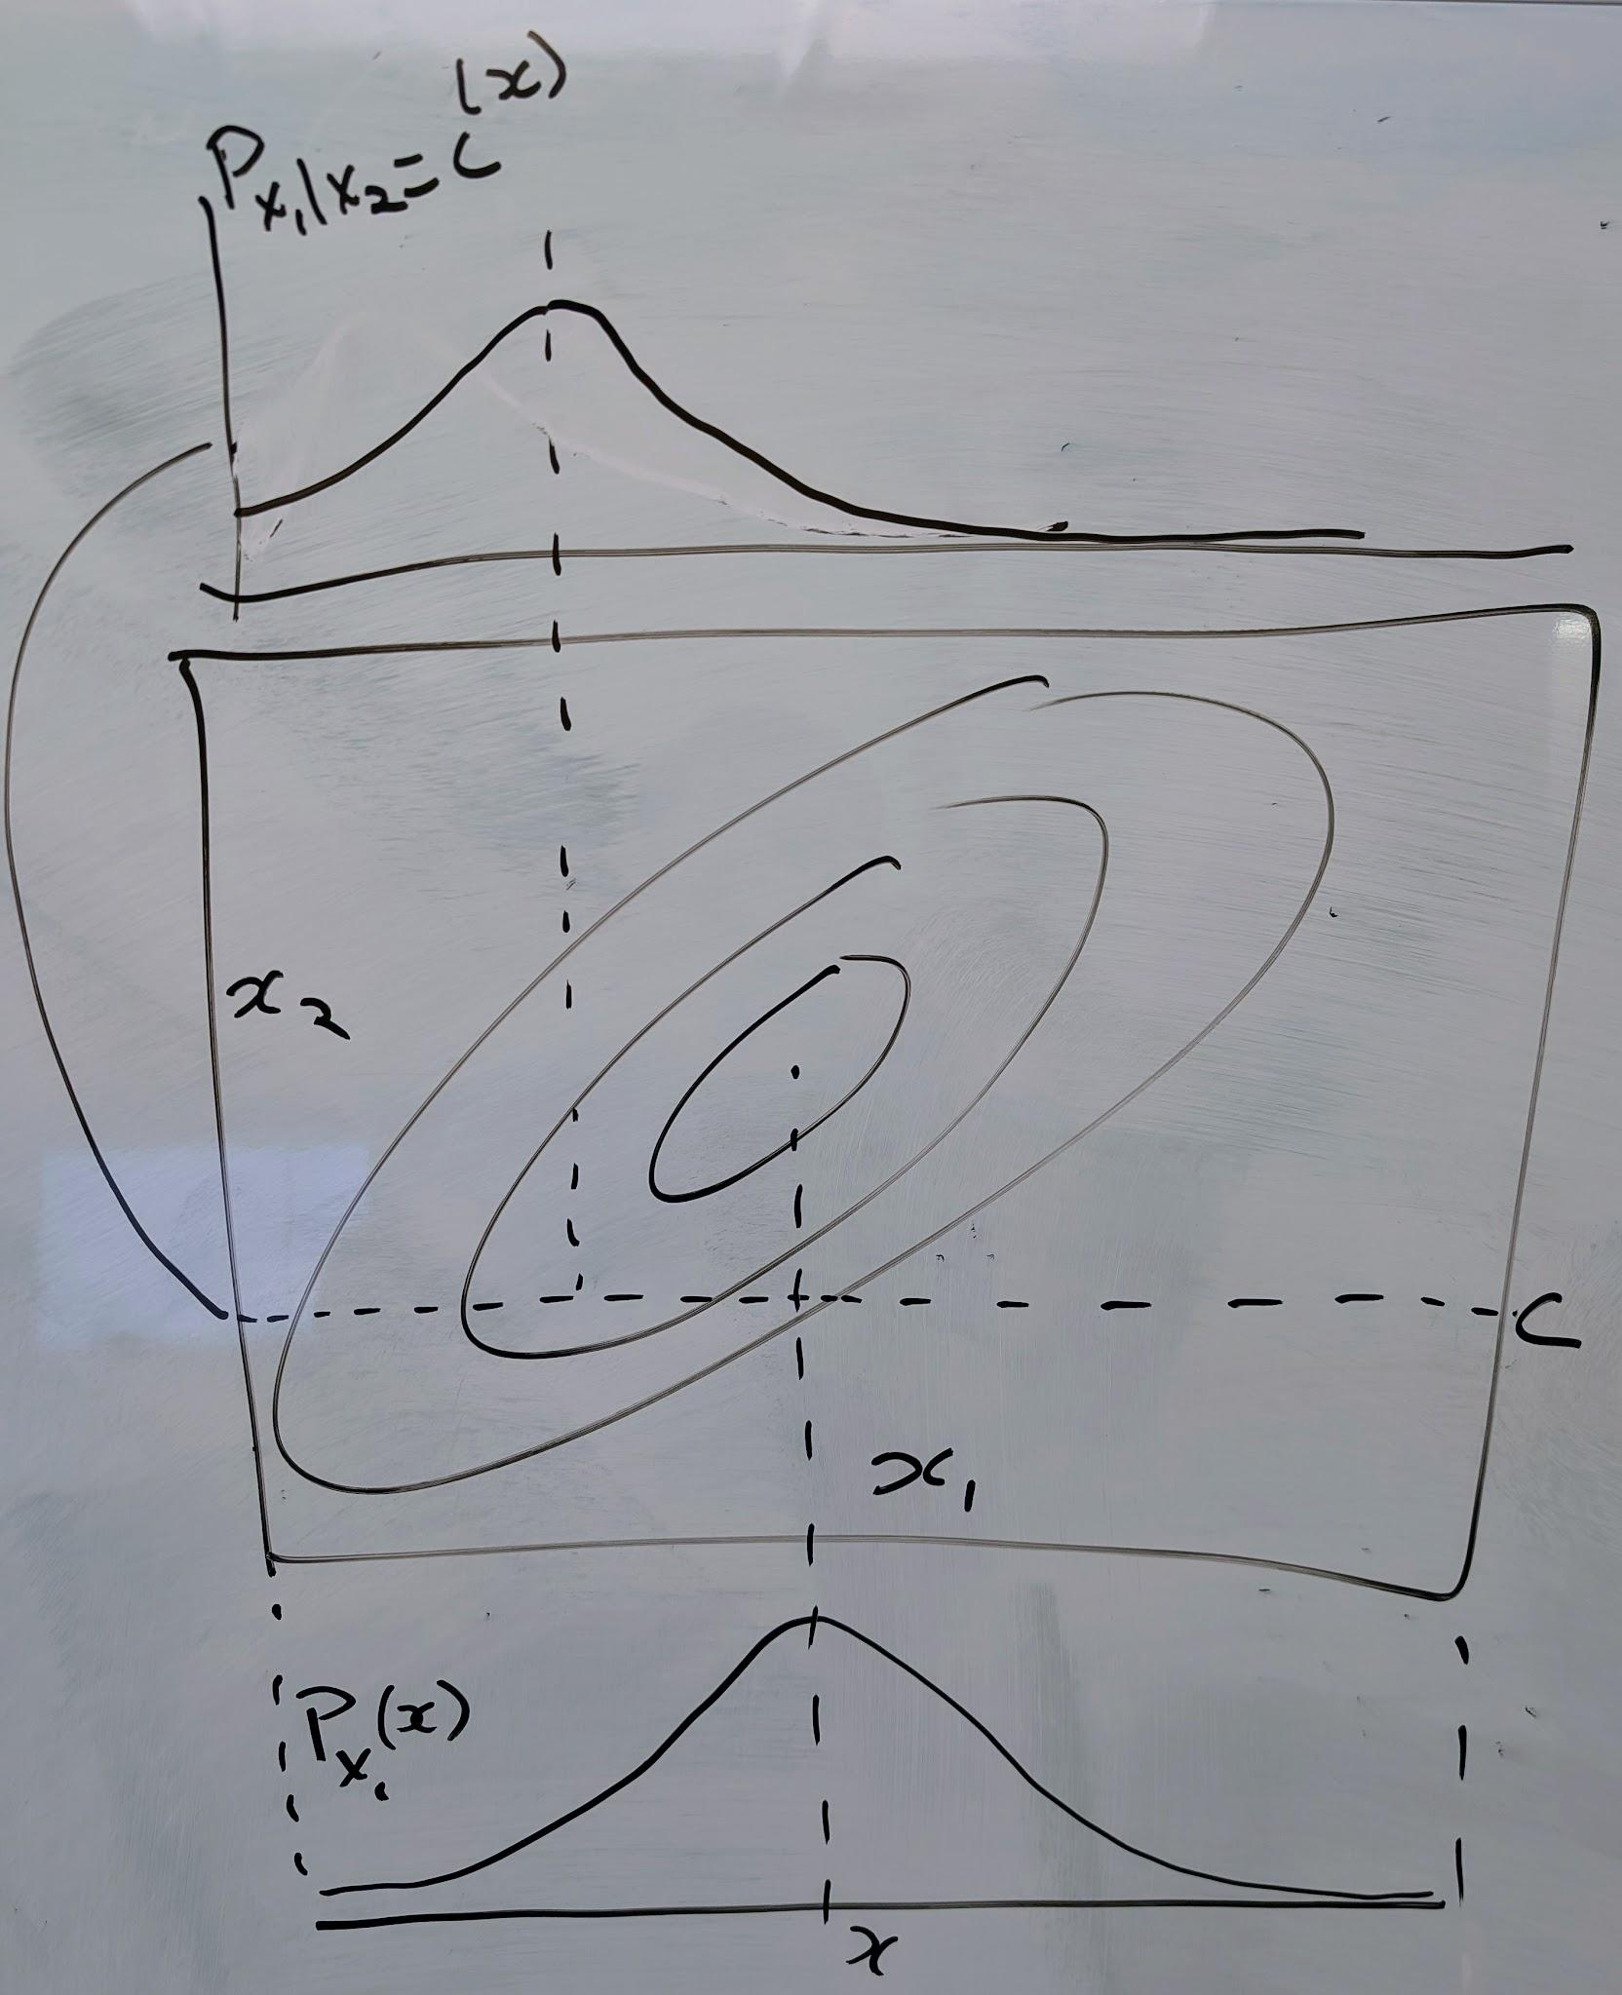

Slide 46
Example: Two dice!

Slide 47
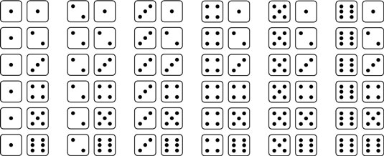

Slide 48
Example: Two dice and their sum!

Slide 49
